Slide 1
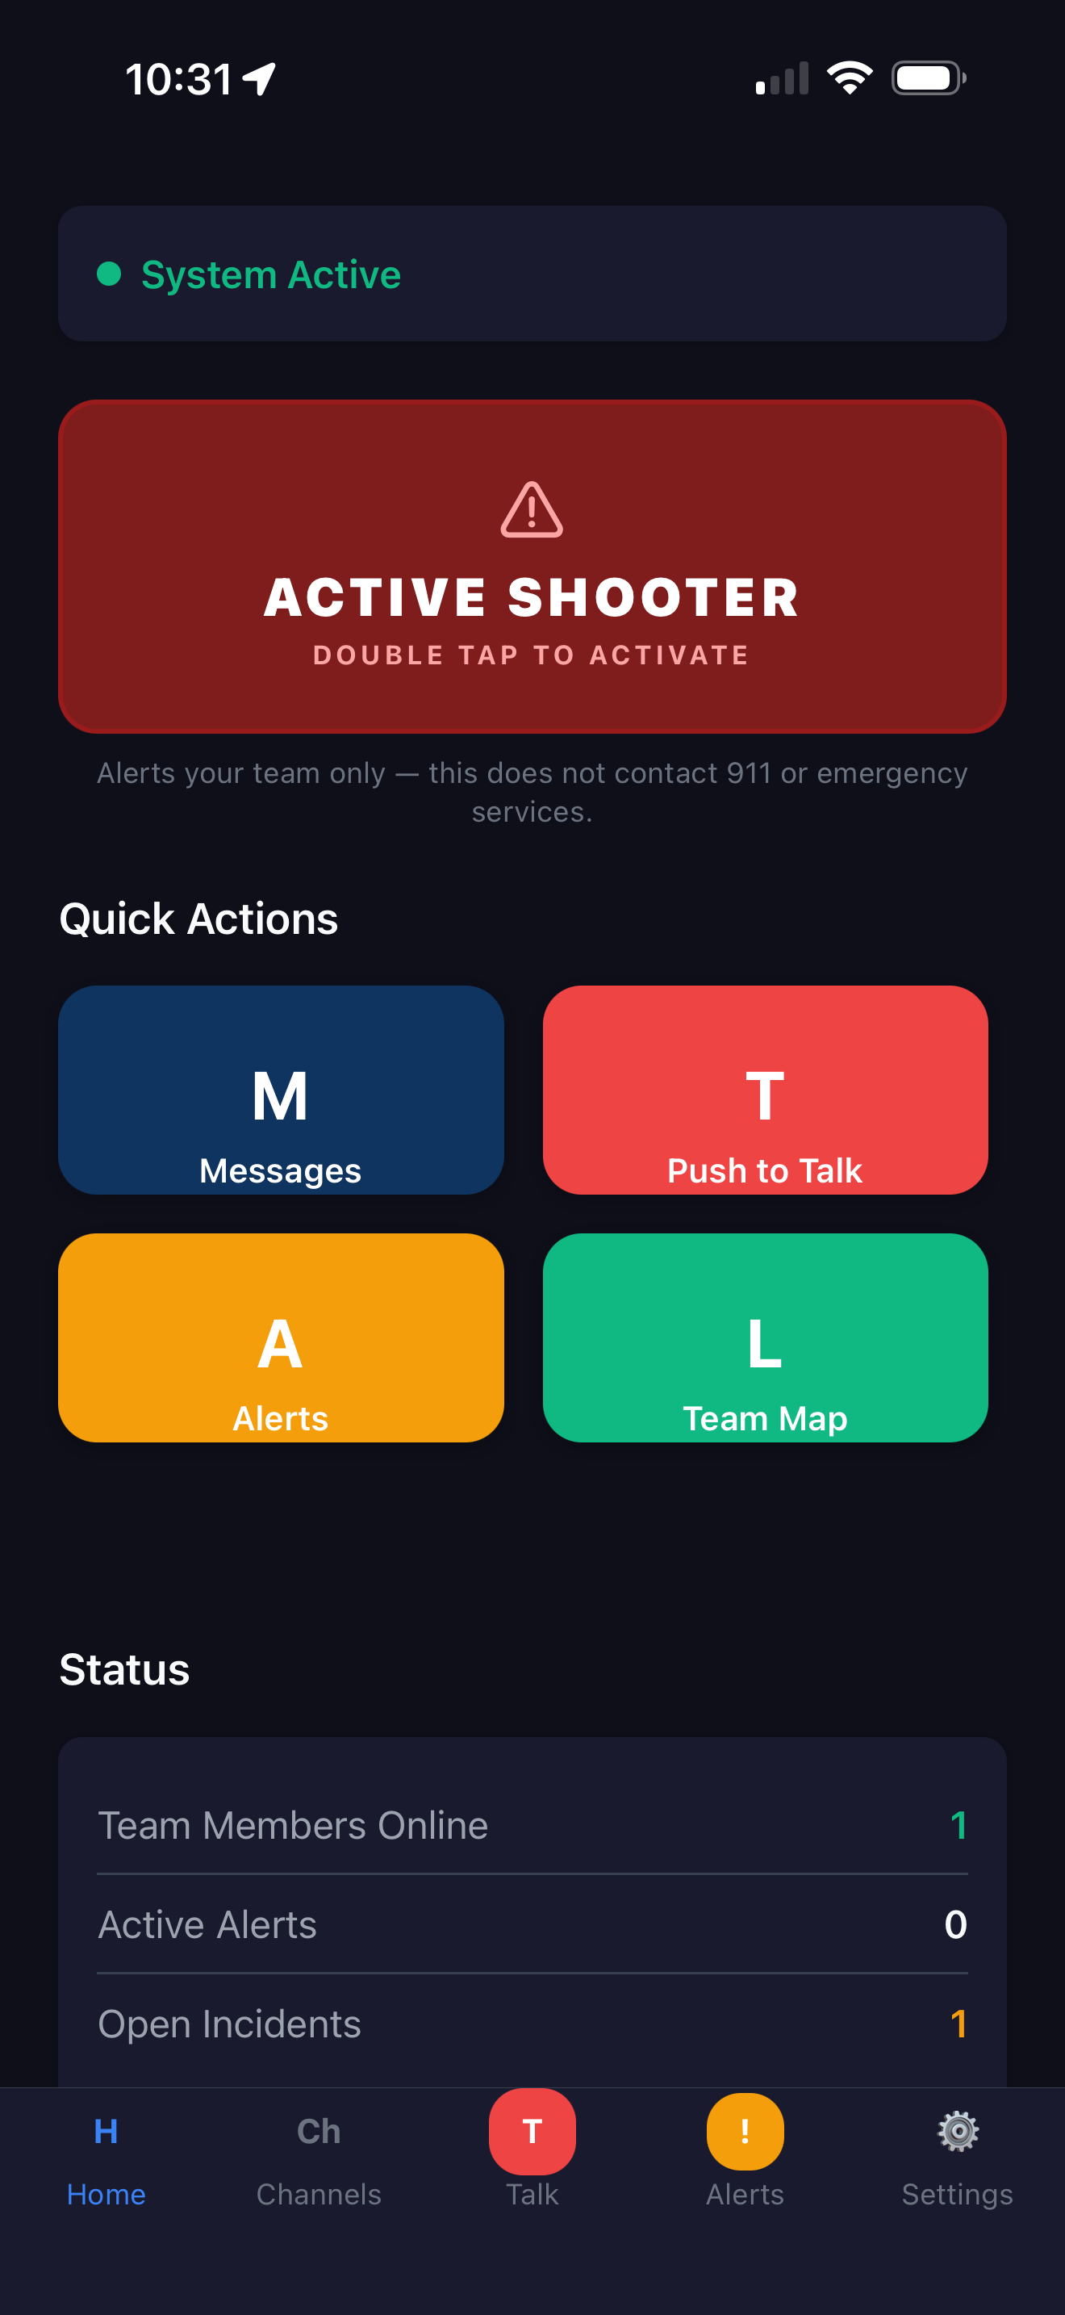
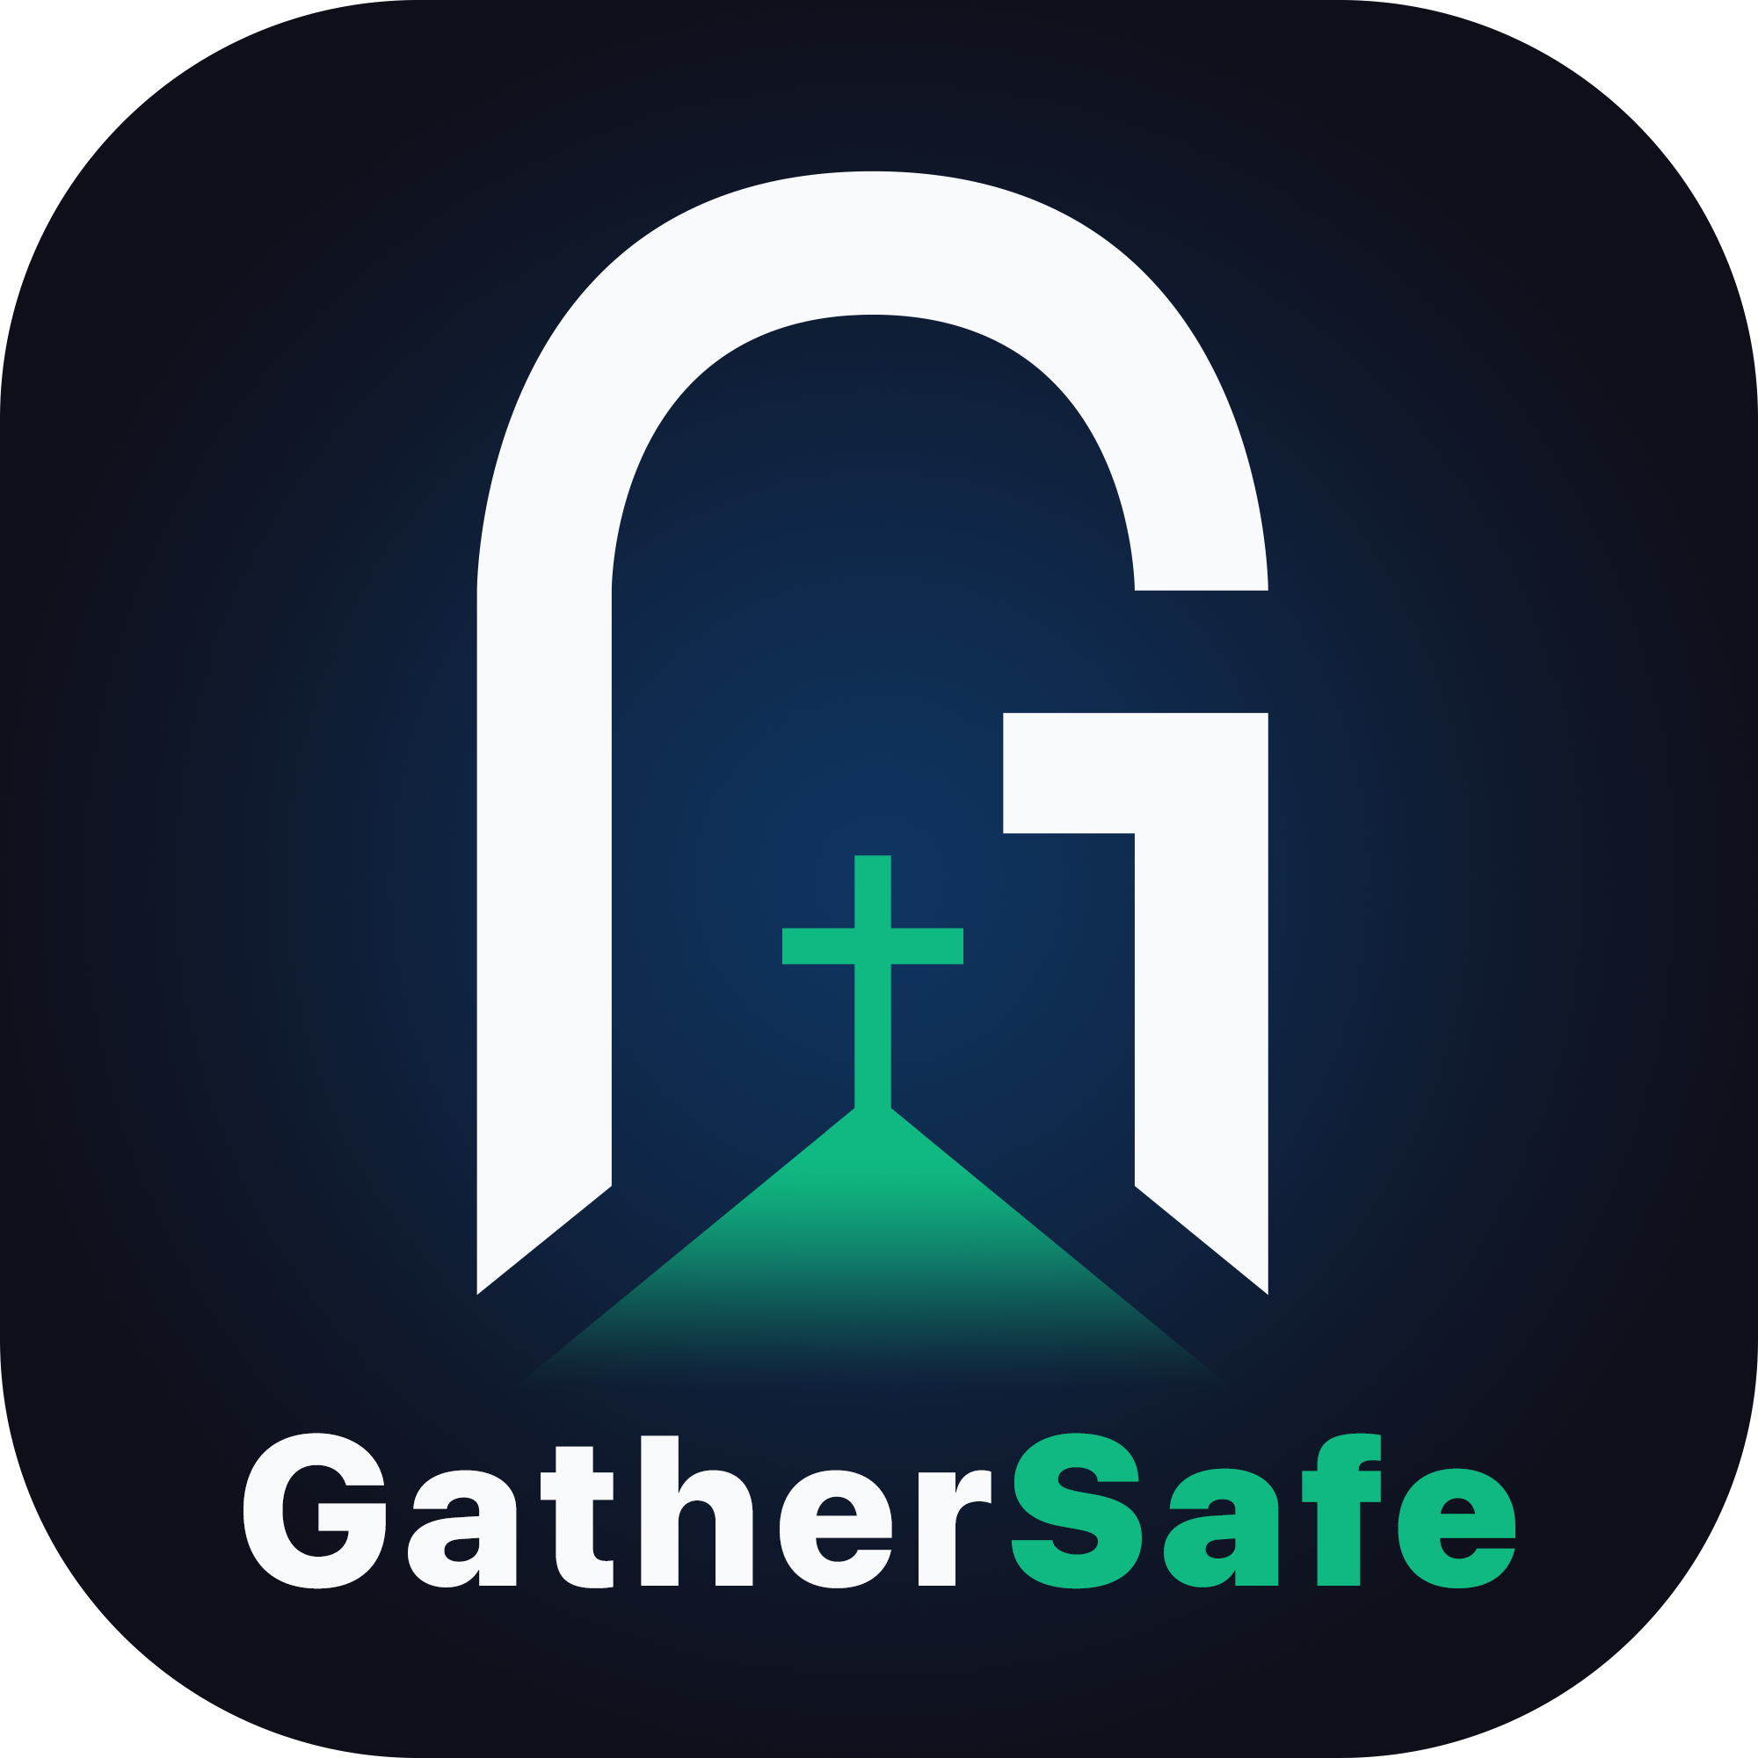
GatherSafe
Secure communication for church security teams
Voice, messaging, alerts, and scheduling in one app
Notes:
Introduce GatherSafe: one secure app that replaces scattered texts and radios for a church security team.

Slide 2



Why a dedicated app for security teams
Seconds matter
Everyone on the same page
A record you can rely on
One tap sends an alert to the whole team, and one button talks to everyone at once.
Leaders see every team. Each team sees only its own channel.
Alerts, incidents, and schedules are logged so you can review and improve.
Notes:
Frame the need: speed, shared awareness, accountability.

Slide 3




Everything your team needs in one place
Push-to-talk
Messaging
Instant voice to the team
Private group chat
Alerts
Scheduling
One tap to the whole team
Who serves, and when
Notes:
The home screen shows who is online, active alerts, and open incidents at a glance.

Slide 4
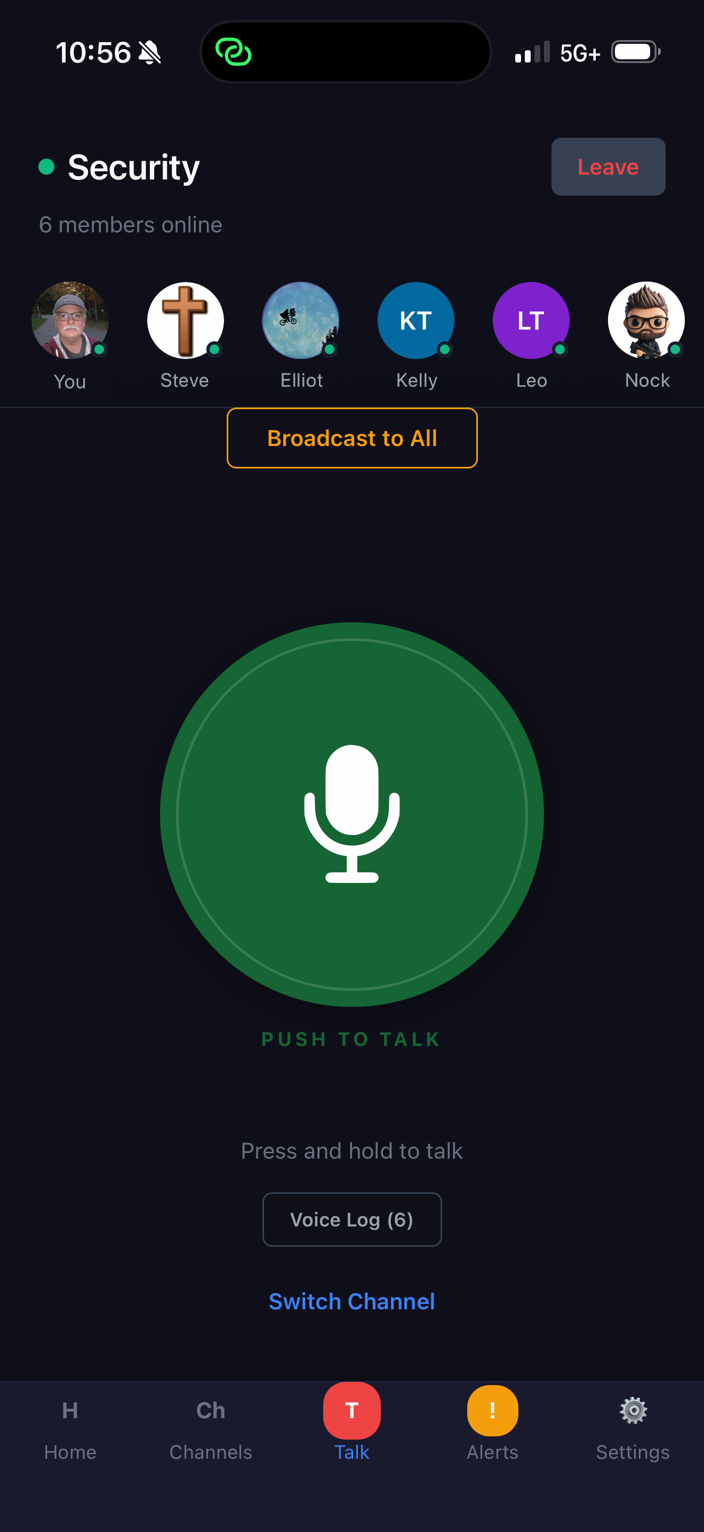
Push-to-talk voice
Press and talk. Hold the button and your whole channel hears you.
Broadcast to all. Leaders can reach every team at once.
See who is online. Members show on the channel as they join.
Set channel hours. Voice opens and closes on a weekly schedule, so Sunday chatter stays on Sunday.
Use hardware buttons. Works with supported Bluetooth push-to-talk accessories.
Notes:
Members choose to join the voice channel. Once joined they stay connected until they leave or the channel closes.

Slide 5
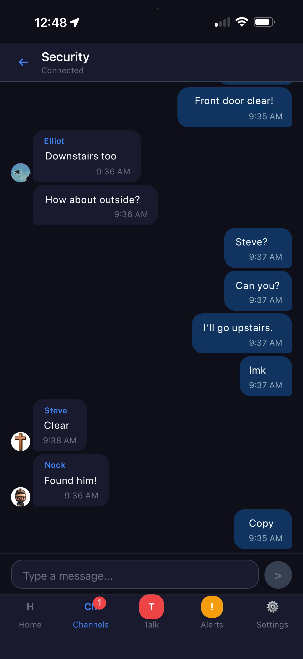
Private team messaging
Group chat. Every team has its own channel for quick coordination.
Encrypted. Messages are encrypted in transit and stored encrypted.
Reliable. Messages queue when the signal drops and send when it returns.
Chat stays on. Messaging and alerts are always available, even when voice is closed.
Notes:
Chat is separate from voice hours. Voice channel schedules never block chat or alerts.

Slide 6
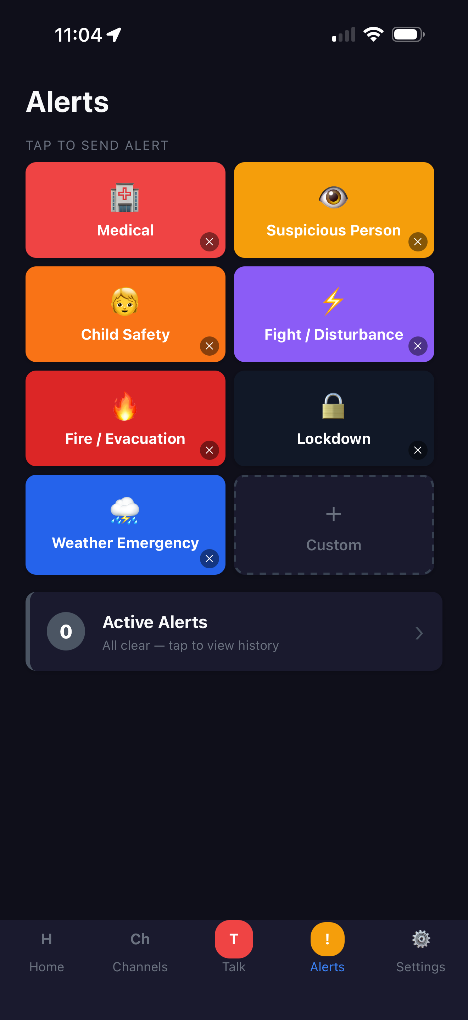
One-tap team alerts
Ready-made alerts. Medical, suspicious person, child safety, fight, fire, lockdown, weather, and your own custom types.
Reaches every member. Alerts go to every member's phone, whether or not they are serving that day.
Team only. Alerts notify your team. They do not contact 911.
Notes:
Alerts go to all members by design. Anyone present at a service is part of the security team that day.

Slide 7
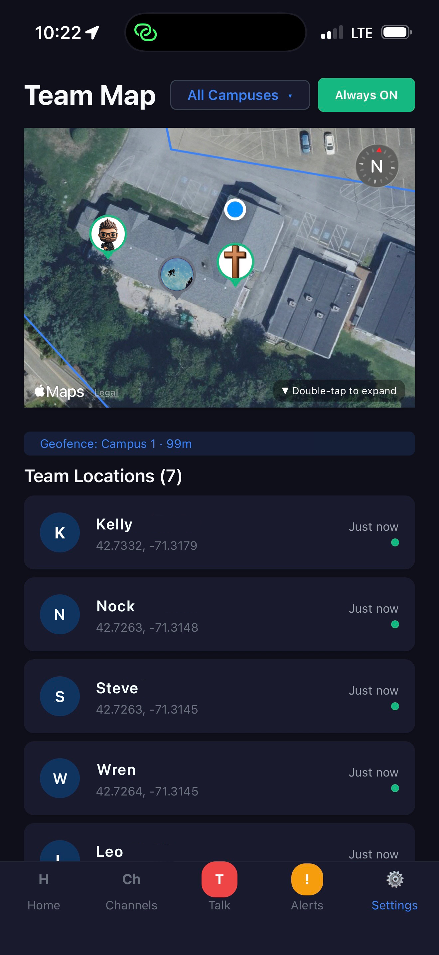
Team map and arrival reminders
See your team. A live map shows where members who share their location are.
Opt-in sharing. Location sharing is each member's choice, and they can turn it off.
Arrival reminders. Members who turn them on get a reminder when they reach your campus.
Notes:
Geofence reminders only work for members who enable them, because they rely on location access.

Slide 8
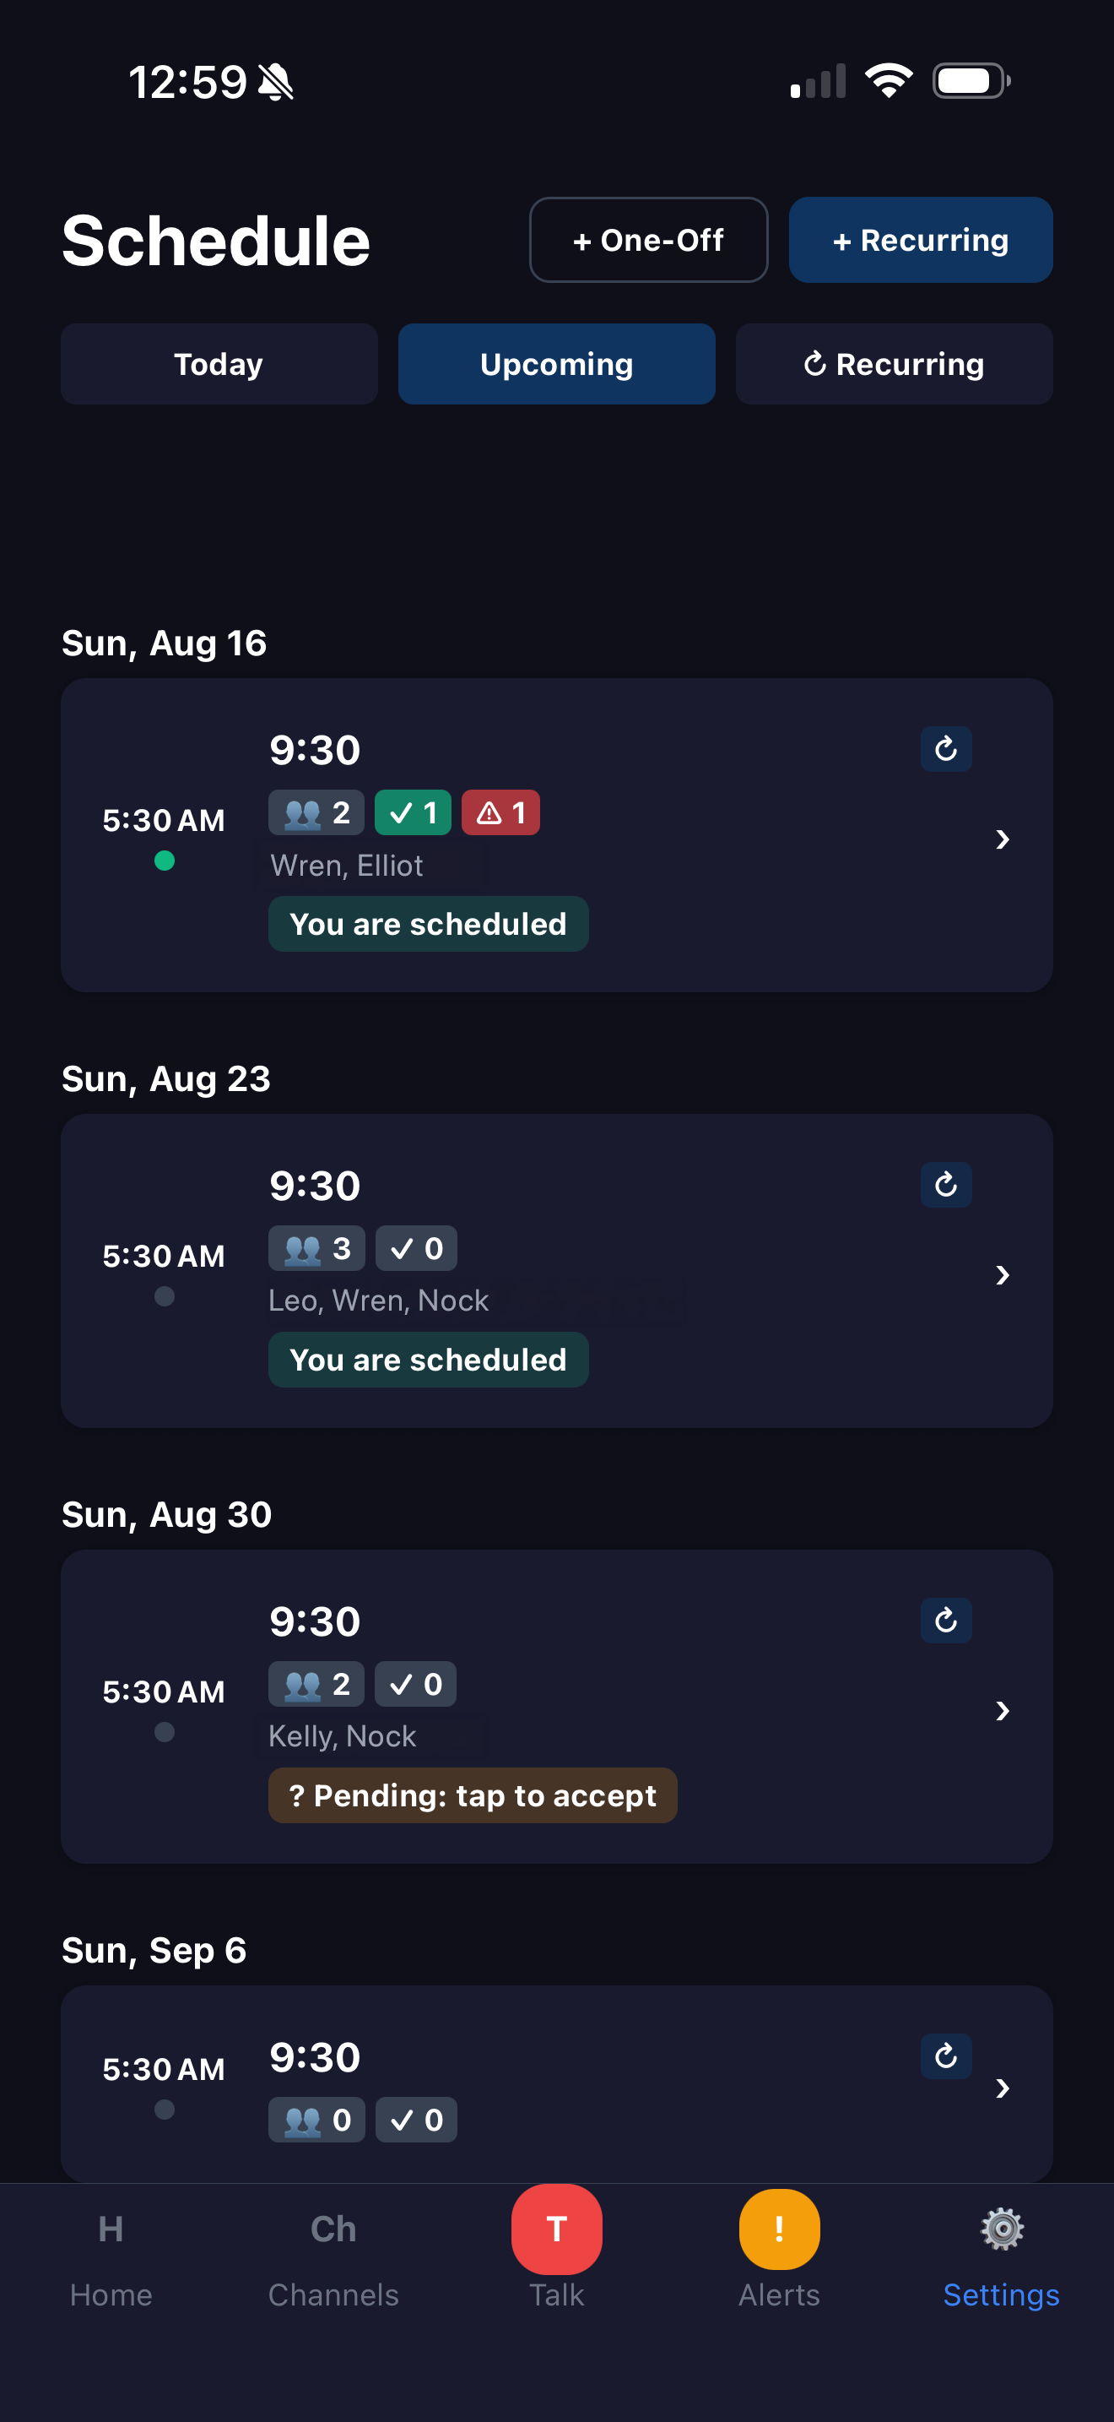
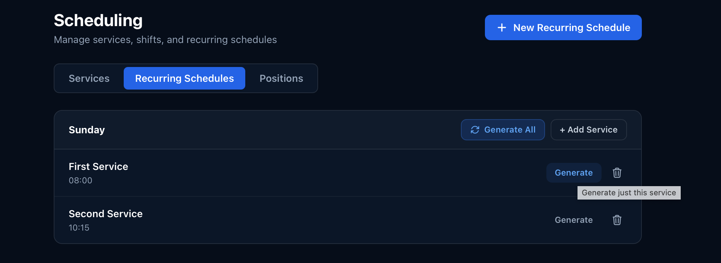
Scheduling and sign-up
Recurring services generate weeks ahead in your time zone.
Members sign up for the services they will serve.
Assign positions, check in, and request swaps.
Planning Center sync is supported.
Notes:
Admins manage schedules on the web console; members see their shifts in the app. Sign-up requires the latest app build.

Slide 9
Incidents and response plans
Incident reports
Response plans
Record what happened with text, photos, location, and time.
Review the history to spot patterns and train.
Build step-by-step plans ahead of time.
Broadcast a plan in one tap. Each person gets a notification with their steps.
Notes:
Incident records and response plans give the team a repeatable process.

Slide 10
Teams that match how you serve
Security Lead
Lead team sees all. Leaders can follow and speak to every sub-team.
Sub-teams stay focused. Each team sees only its own channel.
Flexible roles. Admins control who can manage groups and members.
Multi-campus. Run several campuses from one organization.
Parking
Interior
Children's Wing
Medical
Example structure
Notes:
Hierarchy: lead group sees everything, sub-groups are isolated from each other.

Slide 11



Readiness and training
Training sessions
Qualifications
Document library
Schedule and track team training.
Record who is trained and certified for what.
Keep procedures and plans where the team can find them.
Notes:
Training and qualification tracking help leaders know their team is prepared.

Slide 12
Two ways to use GatherSafe
With push-to-talk
Connect (no push-to-talk)
Starter, Team, Ministry, Ministry Pro
Connect Starter, Team, Ministry, Pro
Push-to-talk voice on your team's phones
Lead team and sub-teams, with their own channels
Everything in Connect
Chat, alerts, team map, incidents, and scheduling
Same member and campus limits as the matching voice plan
Lower monthly price
Choose this if you want phones to work as your radios, or to add voice to your team.
Choose this if your team already owns two-way radios and needs everything else.
Notes:
Both plan types include chat, alerts, map, incidents, and scheduling. The difference is push-to-talk voice and team structure.

Slide 13





How we protect your team's information
Encrypted connections
AES-256 message encryption
Encrypted at rest
TLS protects every connection between the app and our servers.
Messages are encrypted with a key for each group. Removed members lose team access immediately.
Message content is stored encrypted, not as readable text.
Protected voice
Device lock
Role-based access
Voice travels over encrypted audio streams (SRTP).
PIN or Face ID / fingerprint locks the app on each phone.
Members only reach the teams they belong to. Admins control membership.
Notes:
Describe what is used. Location sharing is opt-in. Full security details are in the handout.

Slide 14
Getting started
1
2
3
4
5
Create
Build
Invite
Set
Go
your organization and campus
lead and sub-teams
members with a code or link
channel hours and your schedule
live on your next service
Notes:
Most churches can be set up in an afternoon.

Slide 15
Questions?
info@gathersafeapp.com
Notes:
Open for questions.

